Slide 1
Data Analysis and Visualisation
Module 5
Supervised Learning and Linear Regression

Slide 2
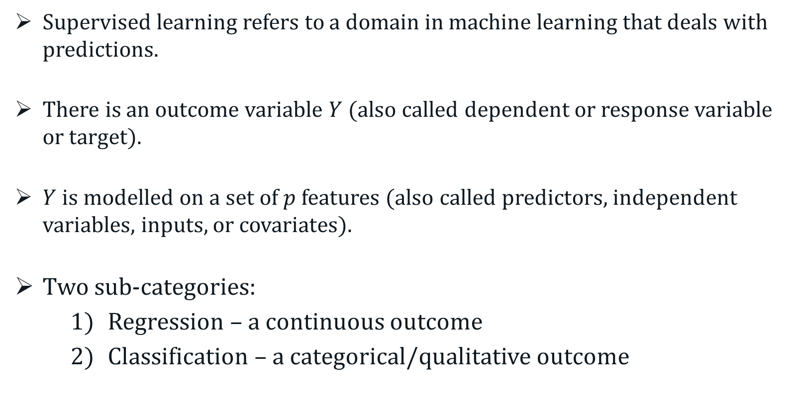
Supervised Learning
Supervised learning refers to a domain in machine learning that deals with predictions.
There is an outcome variable $Y$ (also called dependent or response variable or target).
$Y$ is modelled on a set of $p$ features (also called predictors, independent variables, inputs, or covariates).
Two sub-categories:
Regression – a continuous outcome
Classification – a categorical/qualitative outcome
Notes:
Cluster analysis is an “unsupervised” technique and makes no assumptions regarding the number of groups or the group structure.

Slide 3
Supervised Learning
Goal of Supervised Learning
Primary goal – accurate predictions of unseen cases.
Secondary goal – Assess the relationship between inputs and output and making statistical inferences.
Difficult, if not impossible, with black-box approaches.
Notes:
Cluster analysis is an “unsupervised” technique and makes no assumptions regarding the number of groups or the group structure.

Slide 4
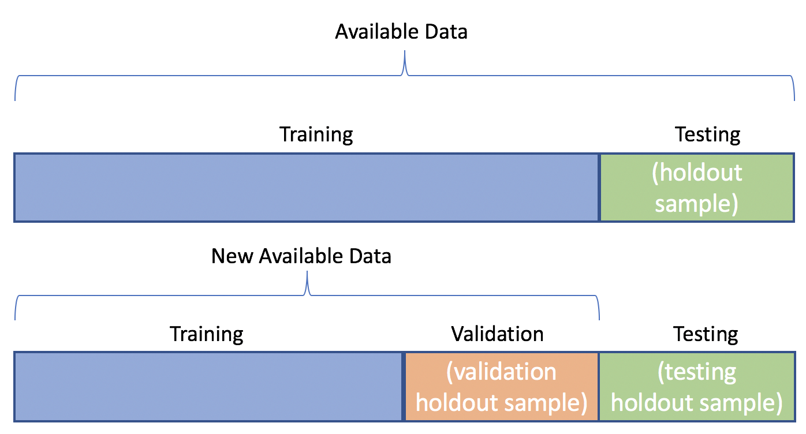
Supervised Learning
Training, Validation and Test Sets
Data are split into two or three partitions:
Training set – Used to build the ML model.
Validation set – Used to tune the ML model.
Test set – Used to evaluate the predictive accuracy of the ML model.
Training and test data splits – 80/20 or 75/25.
Training and validation data – data are split systematically.

Slide 5
Supervised Learning – Cross Validation
Cross-Validation
Cross-validation (CV) is model validation technique to evaluate and compare different ML models to each other.
It can also be used to detect overfitting of models.
In many ML methods, CV is used for tuning hyperparameter(s), whose values are pre-defined by the user before the learning process commences.
CV is typically implemented in multiple rounds to ensure each sample in the dataset had a chance to be in the validation set, and the end results are combined and/or averaged.
Notes:
CV is performed iteratively and systematically in multiples round in such a way that each sample in the training set has a chance to be in the validation set. After several rounds of CV, the results are combined and/or are often averaged.

Slide 6
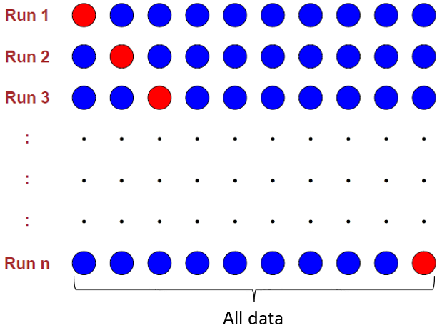
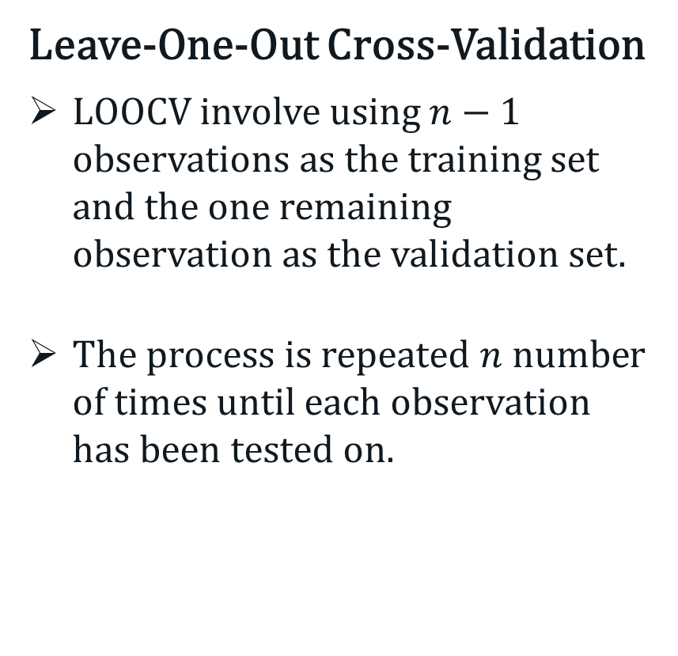
Supervised Learning – Cross Validation
Leave-One-Out Cross-Validation
LOOCV involve using $n−1$ observations as the training set and the one remaining observation as the validation set.
The process is repeated $n$ number of times until each observation has been tested on.

Slide 7
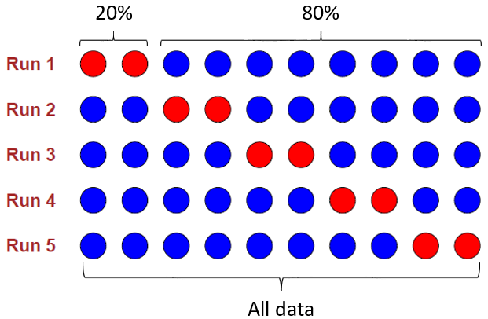
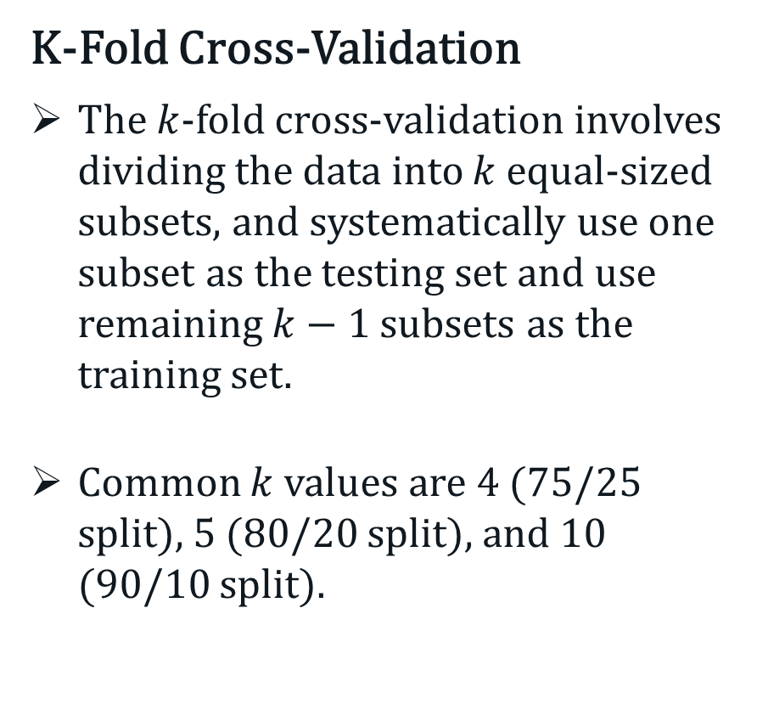
Supervised Learning – Cross Validation
K-Fold Cross-Validation
The $k$-fold cross-validation involves dividing the data into $k$ equal-sized subsets, and systematically use one subset as the testing set and use remaining $k−1$ subsets as the training set.
Common $k$ values are 4 (75/25 split), 5 (80/20 split), and 10 (90/10 split).

Slide 8
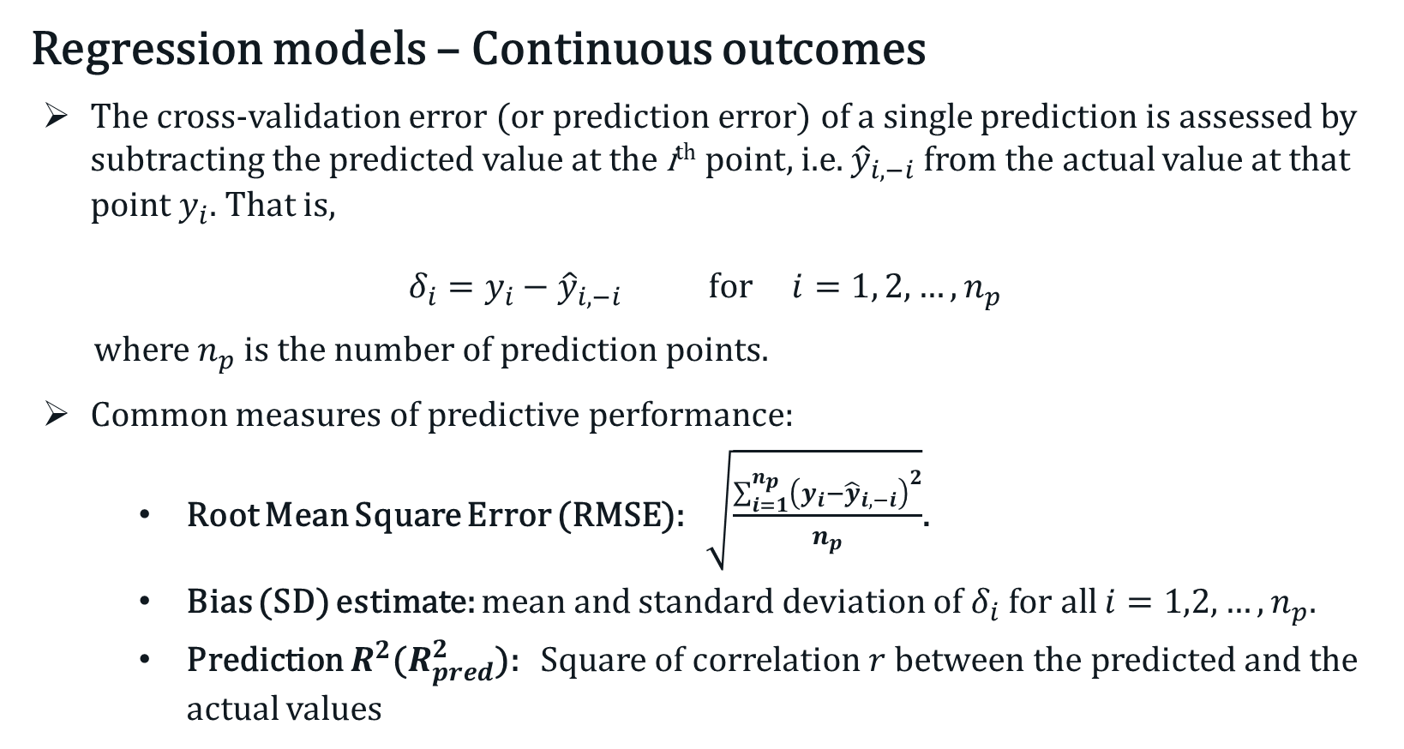
Supervised Learning – Quality of Predictions
Regression models – Continuous outcomes
The cross-validation error (or prediction error) of a single prediction is assessed by subtracting the predicted value at the i^{th} point, i.e. ${\hat{y}}_{i, −i}$ from the actual value at that point $y_{i}$. That is,
$$δ_{i}=y_{i}−{\hat{y}}_{i, −i} \text{for} i=1, 2, …, n_{p}$$
where $n_{p}$ is the number of prediction points.
Common measures of predictive performance:
Root Mean Square Error (RMSE): $\sqrt{\frac{\sum_{i=1}^{n_{p}}{{\left(y_{i}−{\hat{y}}_{i, −i}\right)}^{2}}}{n_{p}}}$.
Bias (SD) estimate: mean and standard deviation of $δ_{i}$ for all $i=1,2, …, n_{p}$.
Prediction $R^{2}$($R_{pred}^{2}$): Square of correlation $r$ between the predicted and the actual values

Slide 9
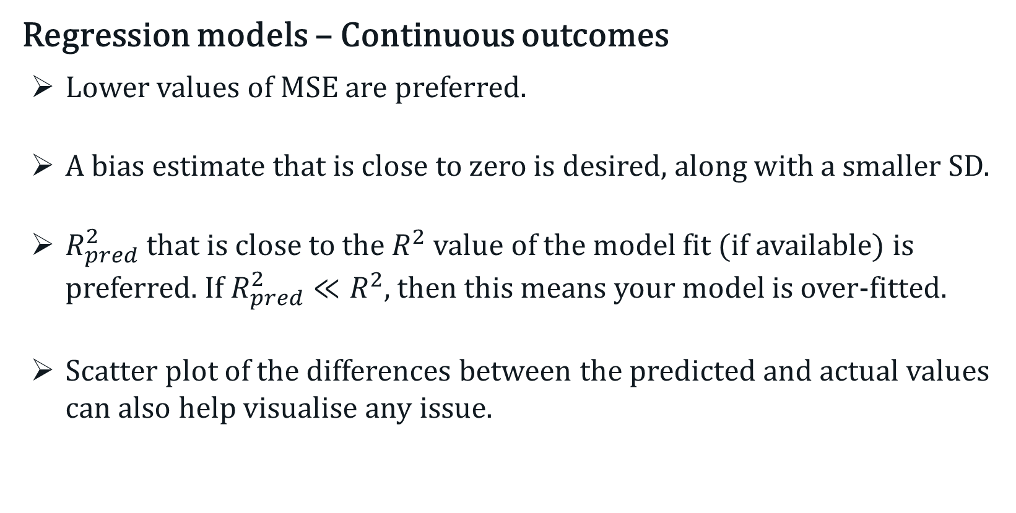
Supervised Learning – Quality of Predictions
Regression models – Continuous outcomes
Lower values of MSE are preferred.
A bias estimate that is close to zero is desired, along with a smaller SD.
$R_{pred}^{2}$ that is close to the $R^{2}$ value of the model fit (if available) is preferred. If $R_{pred}^{2}≪R^{2}$, then this means your model is over-fitted.
Scatter plot of the differences between the predicted and actual values can also help visualise any issue.

Slide 10
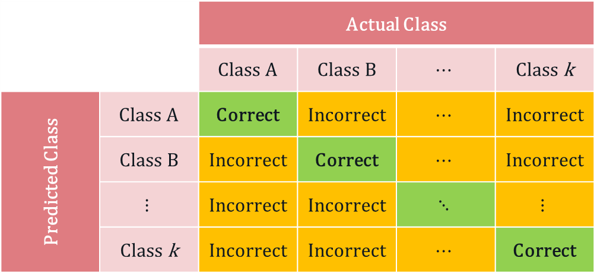
Supervised Learning – Quality of Predictions
Classification models – Categorical outcomes
Contingency table – cross-tabulation between the actual and predicted classes.
 |  | Actual Class
 |  | Class A | Class B | $$⋯$$ | Class k
Predicted Class | Class A | Correct | Incorrect | $$⋯$$ | Incorrect
 | Class B | Incorrect | Correct | $$⋯$$ | Incorrect
 | $$⋮$$ | Incorrect | Incorrect | $$⋱$$ | $$⋮$$
 | Class k | Incorrect | Incorrect | $$⋯$$ | Correct

Slide 11
Supervised Learning – Quality of Predictions
Classification models – Categorical outcomes
Confusion matrix – a 2 × 2 contingency table, i.e. binary outcome
Easy to visualise the degree to which the classifier is confused, i.e. mislabelled the cases.
 |  | Actual Class
 |  | Positive | Negative
Predicted Class | Positive | True positive | False positive (Type I error)
 | Negative | False negative (Type II error) | True negative

Slide 12
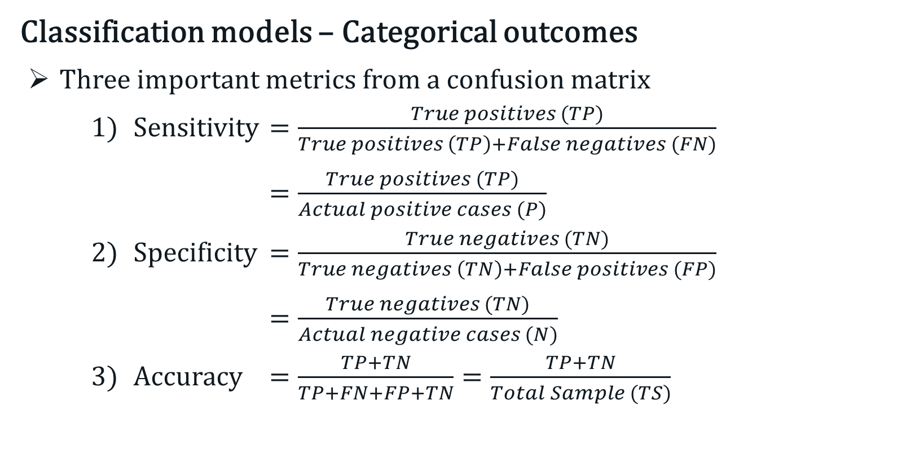
Supervised Learning – Quality of Predictions
Classification models – Categorical outcomes
Three important metrics from a confusion matrix
Sensitivity $=\frac{True positives (TP)}{True positives \left(TP\right)+False negatives (FN)}$
$=\frac{True positives (TP)}{Actual positive cases (P)}$
Specificity $=\frac{True negatives (TN)}{True negatives \left(TN\right)+False positives (FP)}$
$=\frac{True negatives (TN)}{Actual negative cases (N)}$
Accuracy $=\frac{TP+TN}{TP+FN+FP+TN}=\frac{TP+TN}{Total Sample (TS)}$

Slide 13
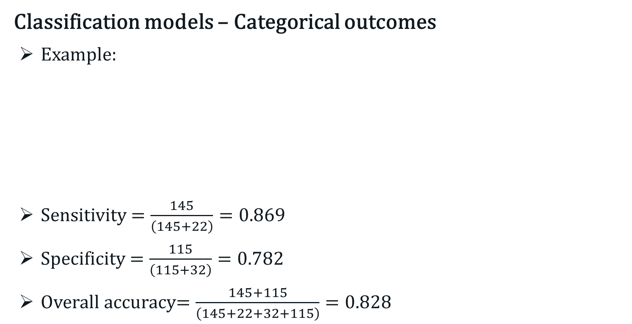
Supervised Learning – Quality of Predictions
Classification models – Categorical outcomes
Example:
Sensitivity $=\frac{145}{\left(145+22\right)}=0.869$
Specificity $=\frac{115}{\left(115+32\right)}=0.782$
Overall accuracy$=\frac{145+115}{\left(145+22+32+115\right)}=0.828$
 |  | Actual Class
Predicted Class |  | Heart Disease | No Heart Disease
Predicted Class | Heart Disease | 145 | 32
 | No Heart Disease | 22 | 115

Slide 14
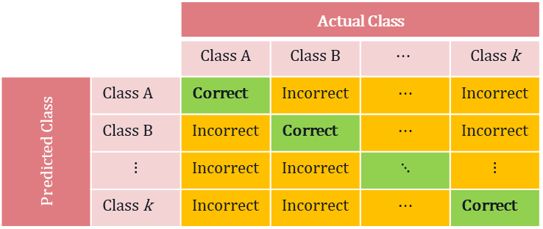

Supervised Learning – Quality of Predictions
Classification models – Categorical outcomes
We can also calculate sensitivity and specificity for a 3 × 3 or 4 × 4 or in general, a k × k contingency table.
 |  | Actual Class
 |  | Class A | All other classes
Predicted Class | Class A | Correct | Incorrect
 | All other classes | Incorrect | Correct
 |  | Actual Class
 |  | Class A | Class B | $$⋯$$ | Class k
Predicted Class | Class A | Correct | Incorrect | $$⋯$$ | Incorrect
 | Class B | Incorrect | Correct | $$⋯$$ | Incorrect
 | $$⋮$$ | Incorrect | Incorrect | $$⋱$$ | $$⋮$$
 | Class k | Incorrect | Incorrect | $$⋯$$ | Correct
$$⋮ ⋮ ⋮ ⋮ ⋮$$
 |  | Actual Class
 |  | Class k | All other classes
Predicted Class | Class k | Correct | Incorrect
 | All other classes | Incorrect | Correct

Slide 15
Supervised Learning
Bias-Variance Trade-Off
A bias in ML refers to the error associated with approximating a real-world problem (e.g. true population model) with a much simpler model.
A variance in ML is the amount of change in a specified training model with a different training set.
The bias-variance trade-off refers to a trade-off that ML methods undergo in an effort to minimise bias and variance.

Slide 16
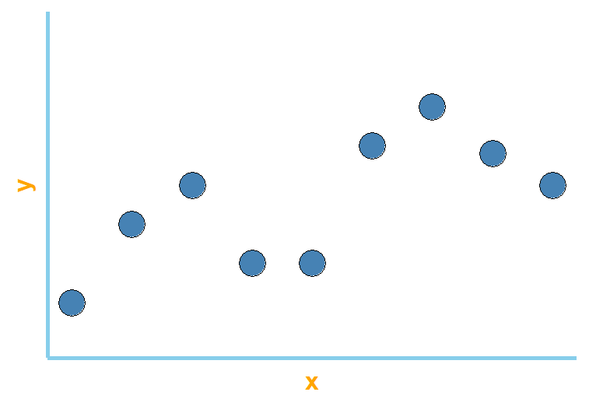

Supervised Learning – Bias-Variance Trade-Off
Suppose we have the following ($x, y$) observations from Population X and Y.

Slide 17
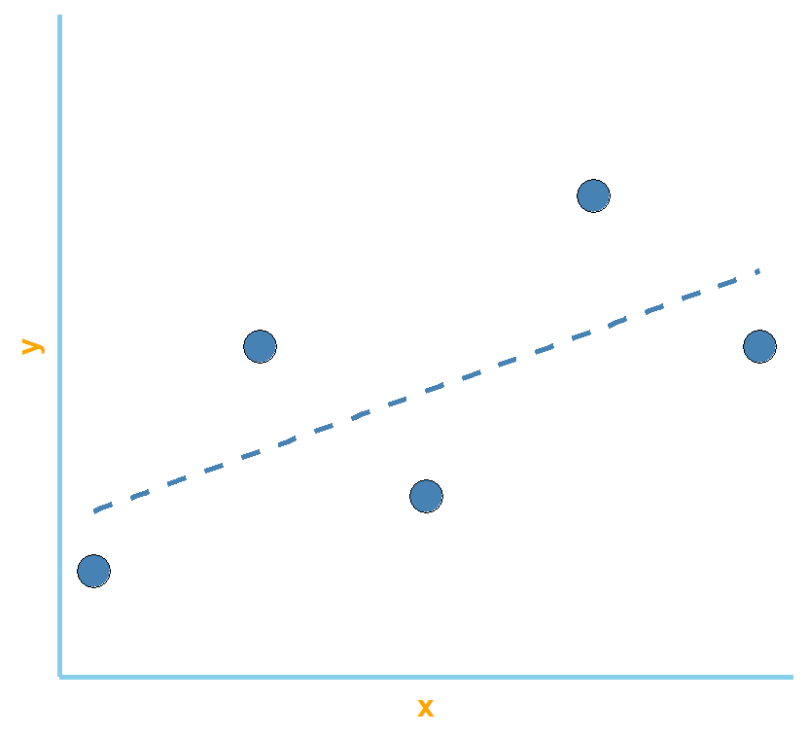
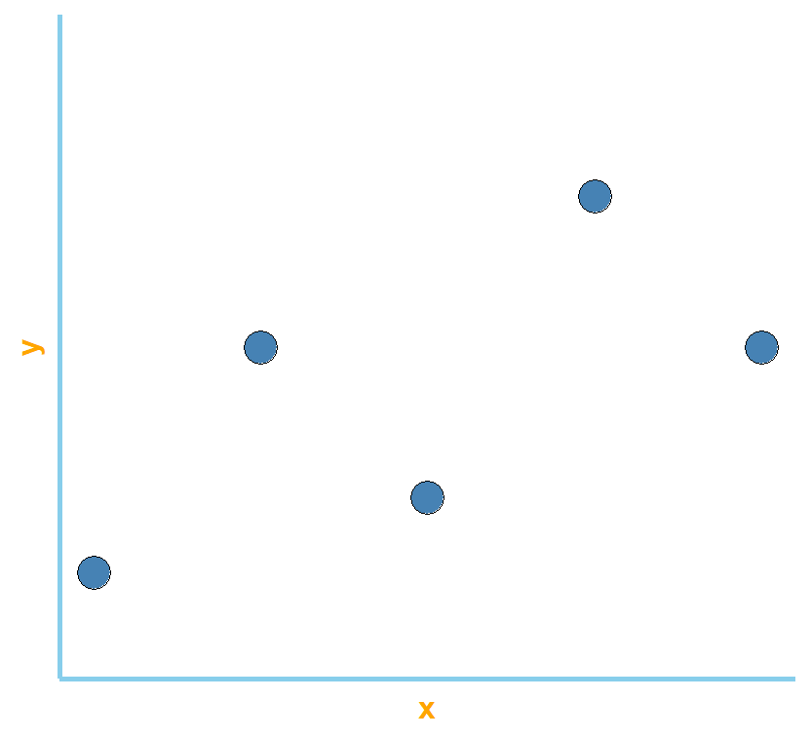
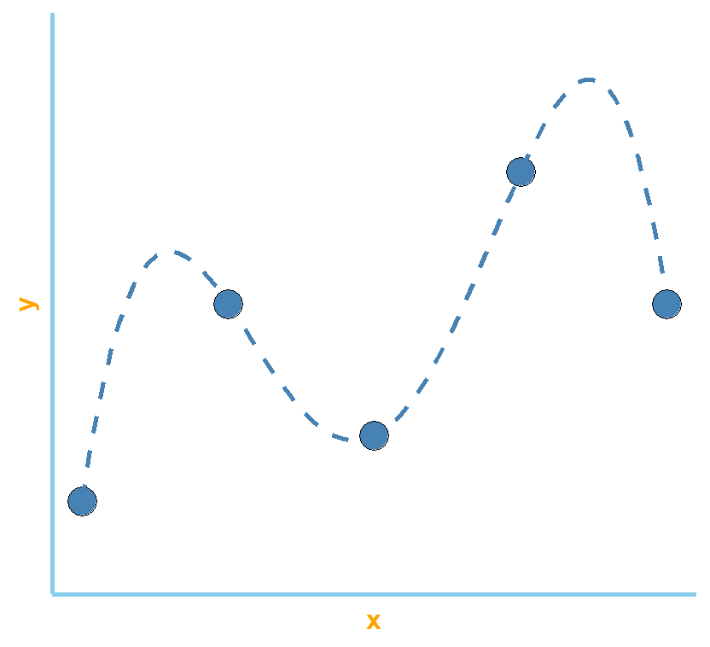

Supervised Learning – Bias-Variance Trade-Off
Suppose we randomly sample five ($x, y$) pairs, and model the data with a linear model and a polynomial of order 4.
High bias
Low Bias

Slide 18
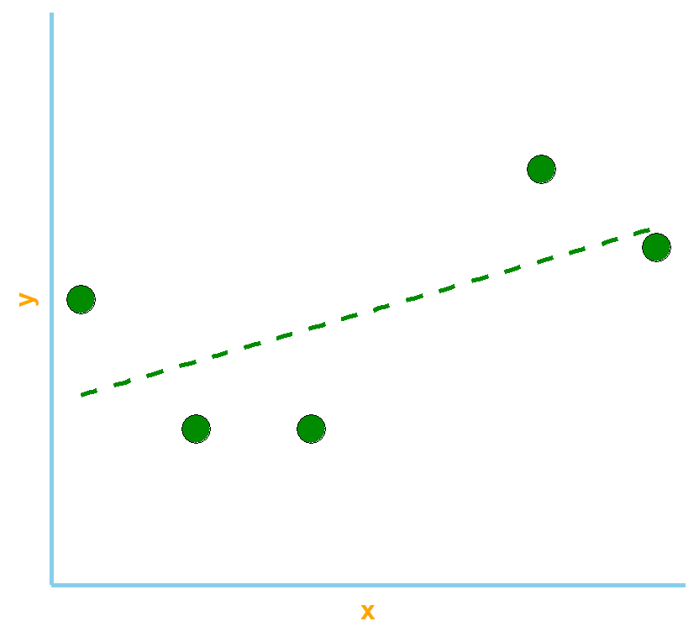
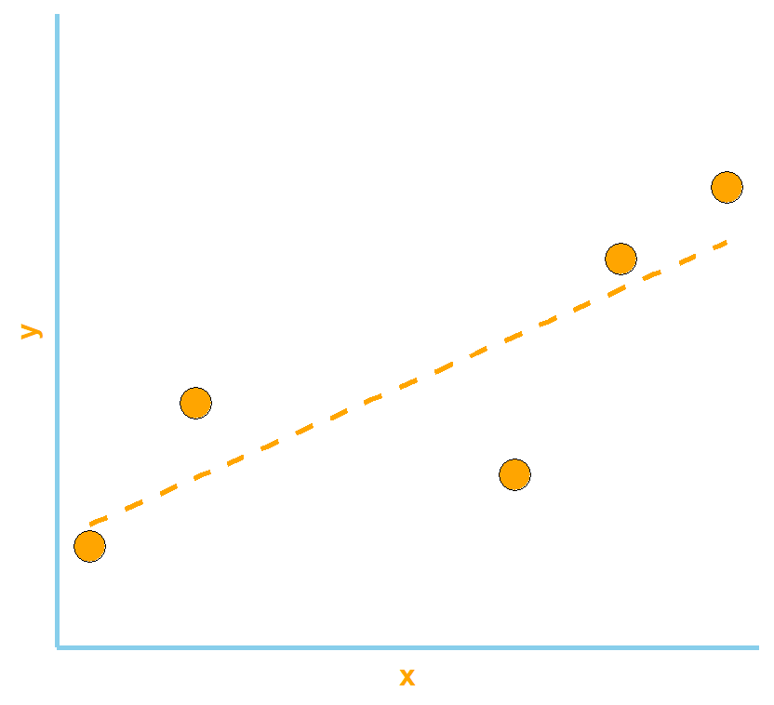
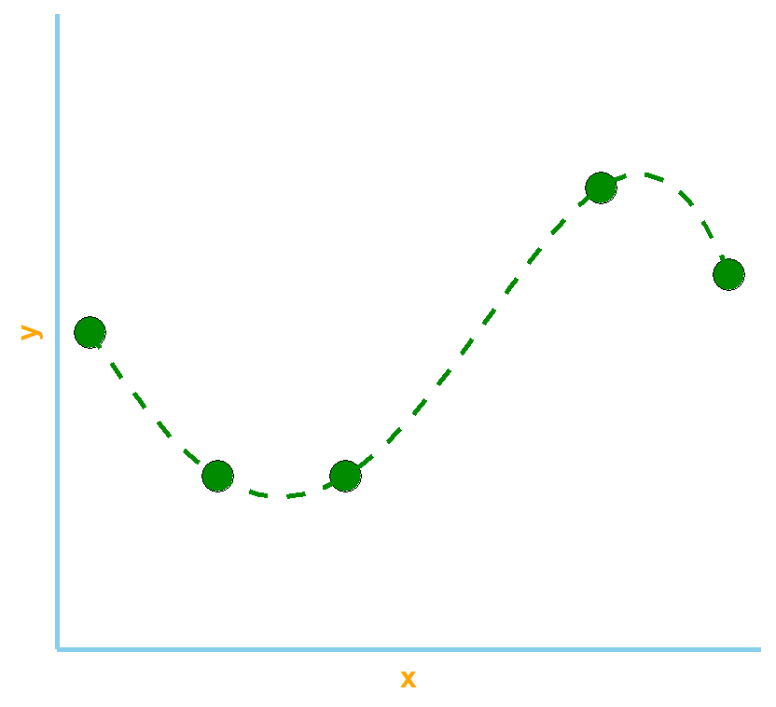
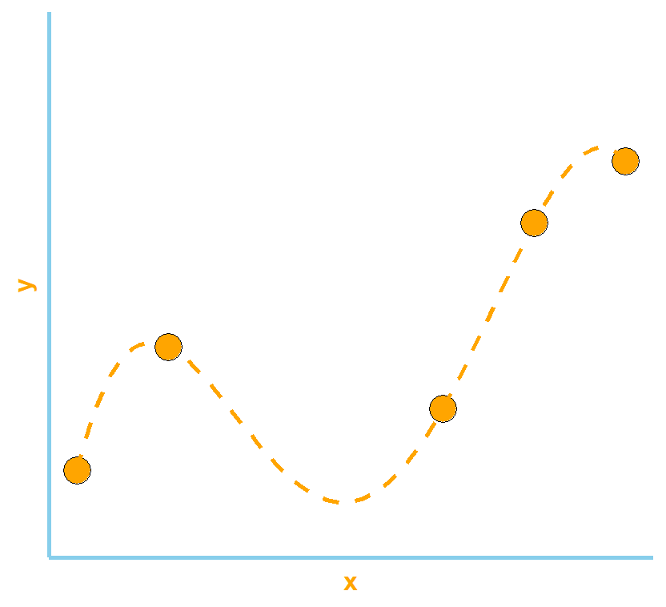

Supervised Learning – Bias-Variance Trade-Off
Suppose now, we randomly sample two more sets of five ($x, y$) pairs from the same populations, and model them with a linear model (top row) and a polynomial of order 4 (bottom row).

Slide 19
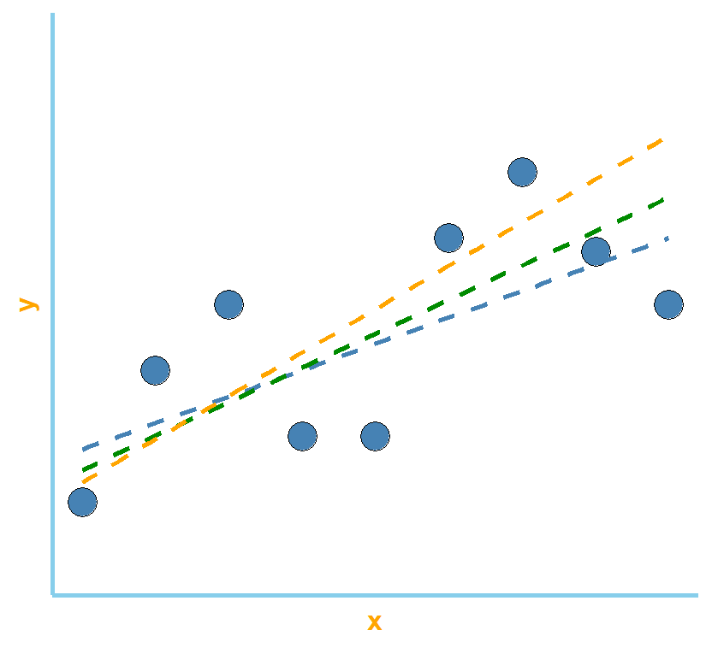
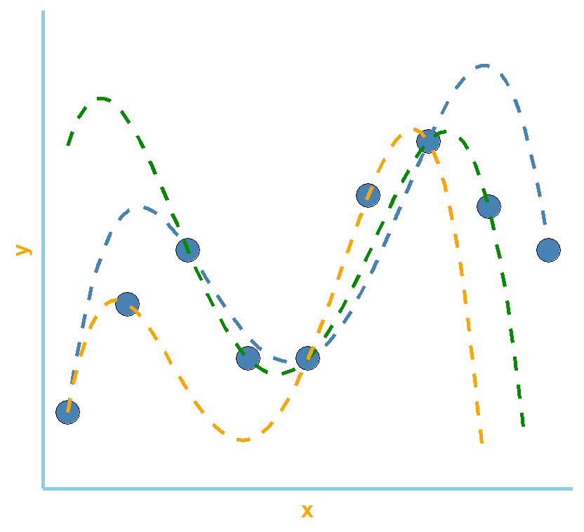
Supervised Learning – Bias-Variance Trade-Off
Combined plots - What difference(s) do you see between the two plots?

Slide 20
Supervised Learning – Bias-Variance Trade-Off
In general, there is an inverse relationship between bias and variance.
An under-fitted (under-parameterised) model will have high bias, but low variance.
An over-fitted (over-parameterised) model will have low bias, but high variance.
A optimal model is one that strikes a balance between bias and variance.
This is achieved through “learning”, i.e. from validation/test data.

Slide 21
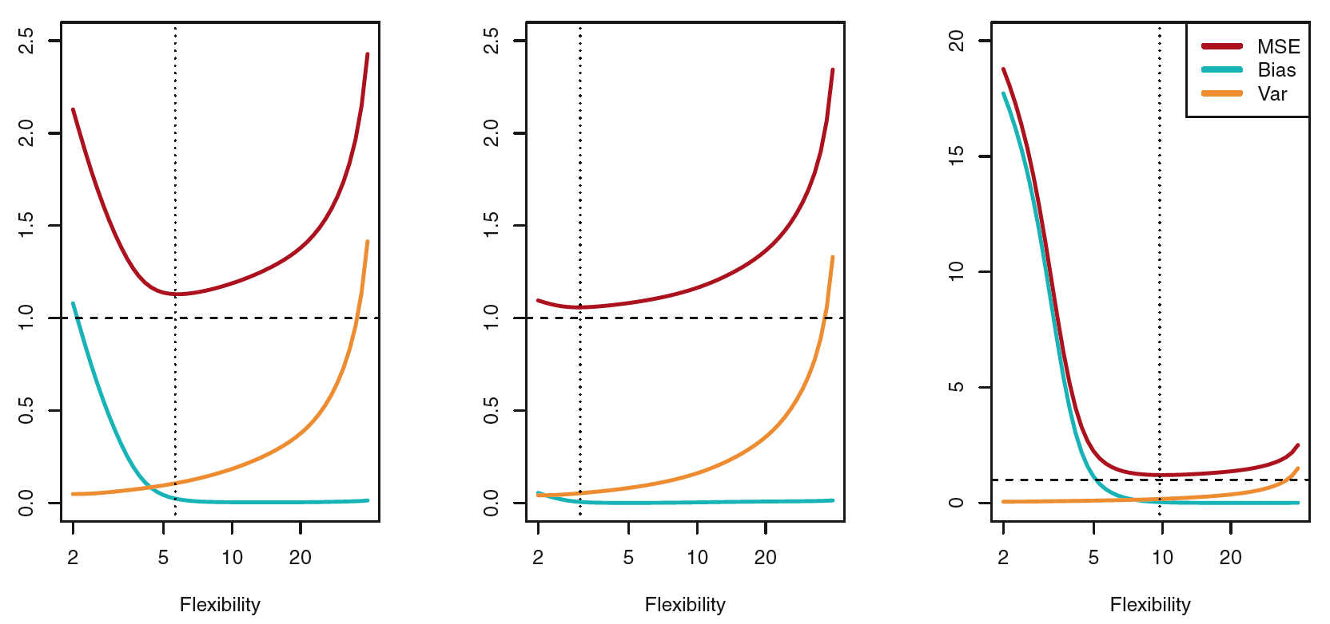
Supervised Learning – Bias-Variance Trade-Off
In the examples below, the optimal model is one with the lowest test mean square error (MSE).
*Figures taken from page 36 of James et al. (2013).

Slide 22
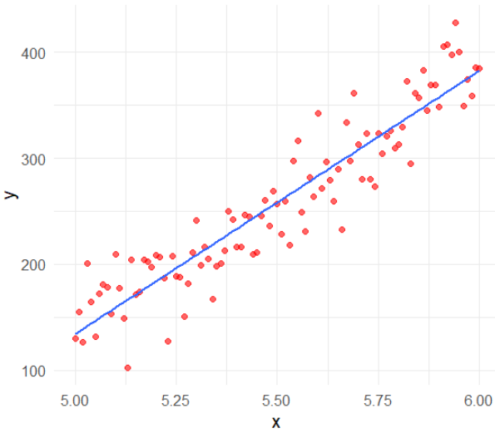
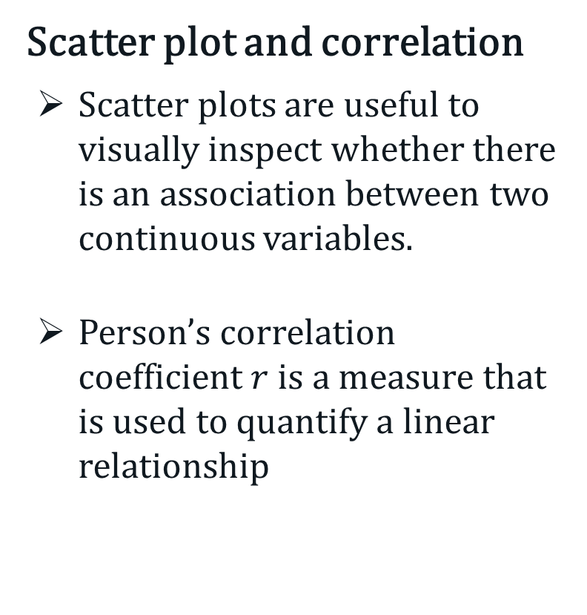
Linear Regression
Scatter plot and correlation
Scatter plots are useful to visually inspect whether there is an association between two continuous variables.
Person’s correlation coefficient $r$ is a measure that is used to quantify a linear relationship

Slide 23
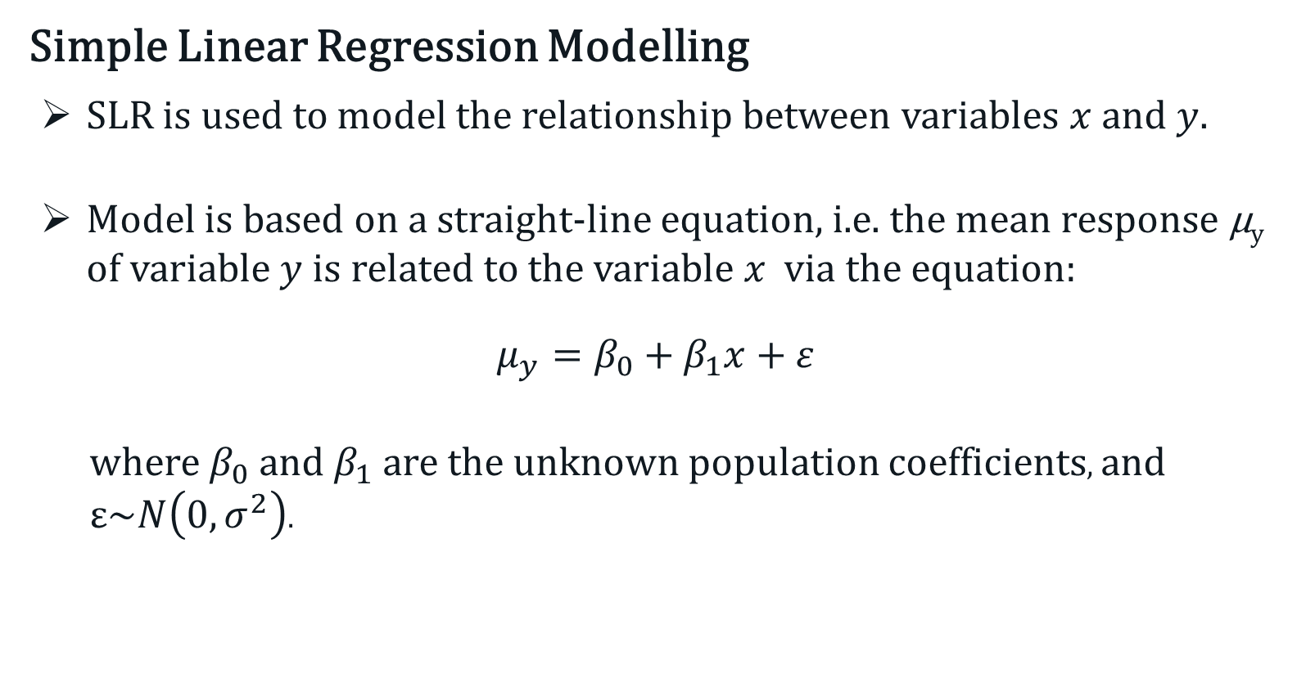
Linear Regression - SLR
Simple Linear Regression Modelling
SLR is used to model the relationship between variables $x$and $y$.
Model is based on a straight-line equation, i.e. the mean response µ_{y} of variable $y$ is related to the variable $x$ via the equation:
$$μ_{y}=β_{0}+β_{1}x+ε$$
where $β_{0}$ and $β_{1}$ are the unknown population coefficients, and $ε\sim N\left(0,σ^{2}\right)$.

Slide 24
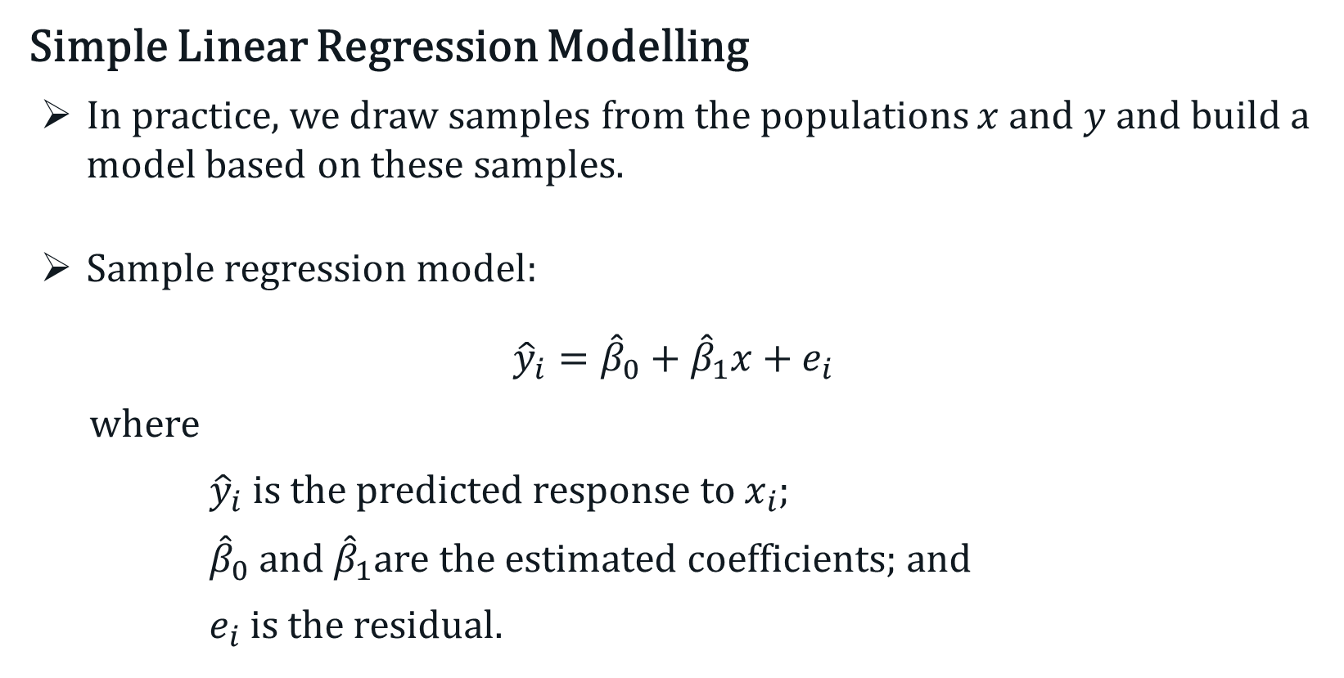
Linear Regression - SLR
Simple Linear Regression Modelling
In practice, we draw samples from the populations $x$and $y$ and build a model based on these samples.
Sample regression model:
$${\hat{y}}_{i}={\hat{β}}_{0}+{\hat{β}}_{1}x+e_{i}$$
where
${\hat{y}}_{i}$ is the predicted response to $x_{i}$;
${\hat{β}}_{0}$ and ${\hat{β}}_{1}$are the estimated coefficients; and
$e_{i}$ is the residual.

Slide 25
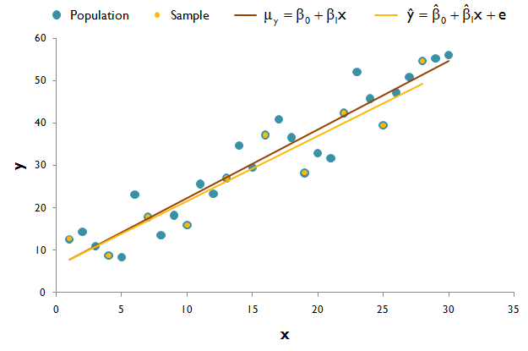
Linear Regression - SLR
Population vs Sample

Slide 26
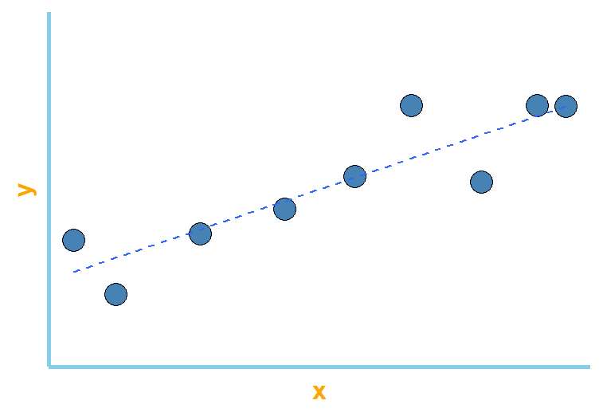
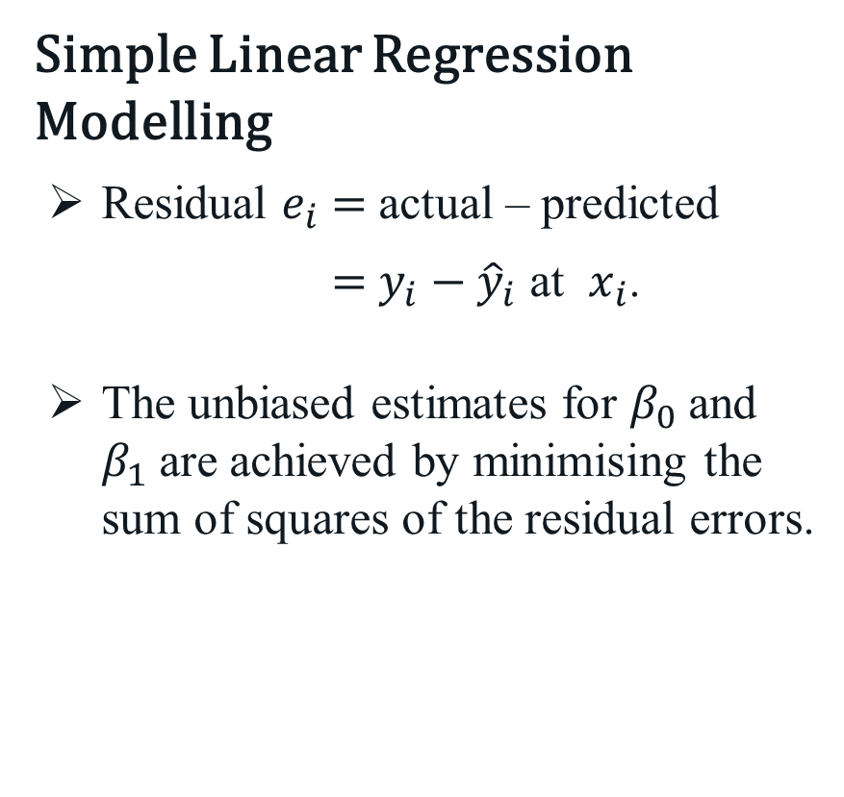
Linear Regression - SLR
Simple Linear Regression Modelling
Residual $e_{i}$ $=$ actual – predicted
$=$ ${y_{i}−\hat{y}}_{i}$ at $x_{i}$.
The unbiased estimates for $β_{0}$and $β_{1}$are achieved by minimising the sum of squares of the residual errors.
e₆
e₇
e₂

Slide 27
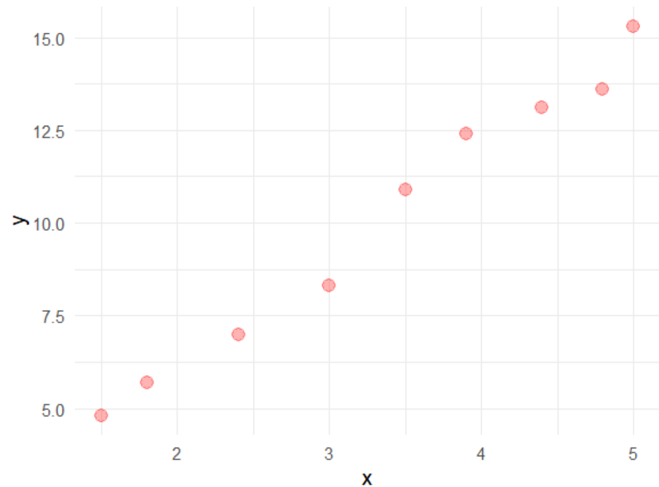
Linear Regression - SLR
Example
Consider the following experimental data .
x | y
1.5 | 4.8
1.8 | 5.7
2.4 | 7.0
3.0 | 8.3
3.5 | 10.9
3.9 | 12.4
4.4 | 13.1
4.8 | 13.6
5.0 | 15.3

Slide 28
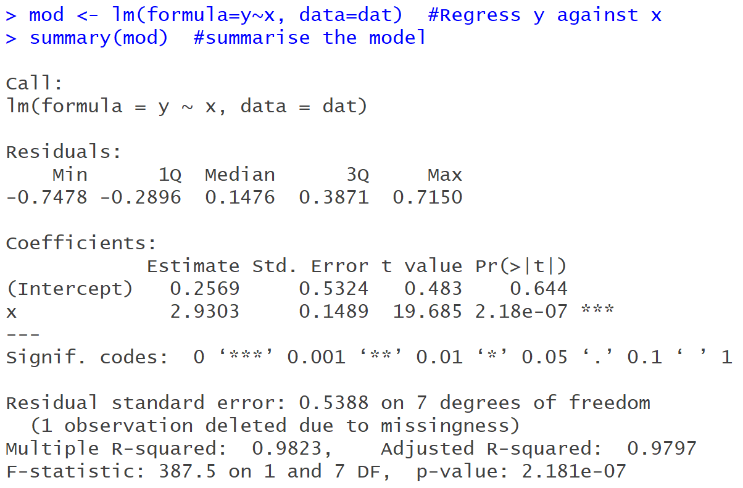

Linear Regression - SLR
Example
Linear regression in R.
Sample Regression Model:
$$\hat{y}=0.2569+2.9303x$$
Significance of $x$ as a predictor of $y$ is defined by a $p$-value.
In this instance, $p$-value $<0.001$, i.e. less than 0.05.
Multiple $R^{2}$ $=0.9823$
Model significance
$⟹$ $p$-value $<0.001$

Slide 29
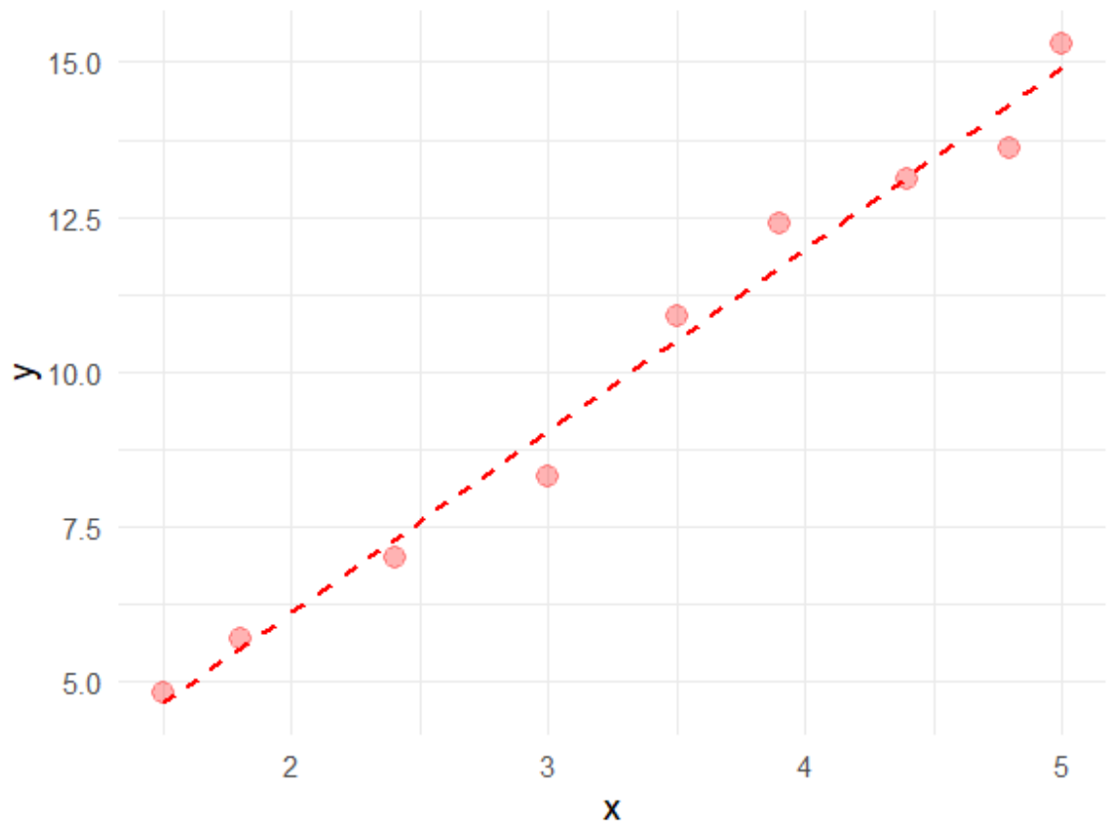
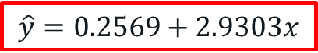
Linear Regression - SLR
Example
Experimental data.
x | y
1.5 | 4.8
1.8 | 5.7
2.4 | 7.0
3.0 | 8.3
3.5 | 10.9
3.9 | 12.4
4.4 | 13.1
4.8 | 13.6
5.0 | 15.3
$$\hat{y}=0.2569+2.9303x$$

Slide 30
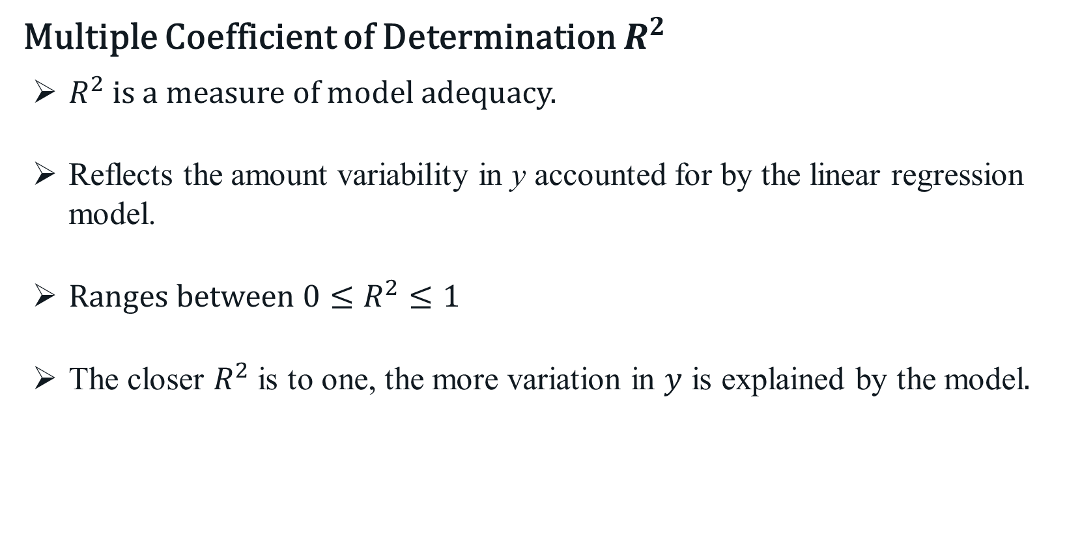
Linear Regression - SLR
Multiple Coefficient of Determination $R^{2}$
$R^{2}$ is a measure of model adequacy.
Reflects the amount variability in y accounted for by the linear regression model.
Ranges between $0≤R^{2}≤1$
The closer $R^{2}$ is to one, the more variation in $y$ is explained by the model$.$

Slide 31
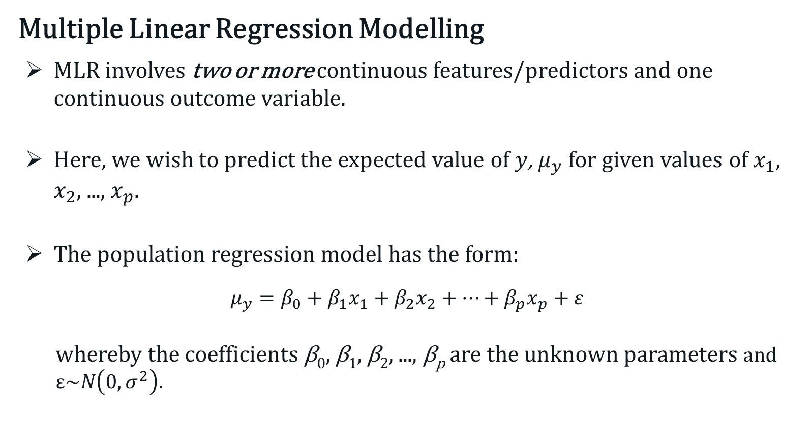
Linear Regression - MLR
Multiple Linear Regression Modelling
MLR involves two or more continuous features/predictors and one continuous outcome variable.
Here, we wish to predict the expected value of $y$, $μ_{y}$ for given values of $x_{1}$, $x_{2}$, ..., $x_{p}$.
The population regression model has the form:
$$μ_{y}=β_{0}+β_{1}x_{1}+β_{2}x_{2}+⋯+β_{p}x_{p}+ε$$
whereby the coefficients β₀, β₁, β₂, ..., β_{p} are the unknown parameters and $ε\sim N\left(0,σ^{2}\right).$

Slide 32
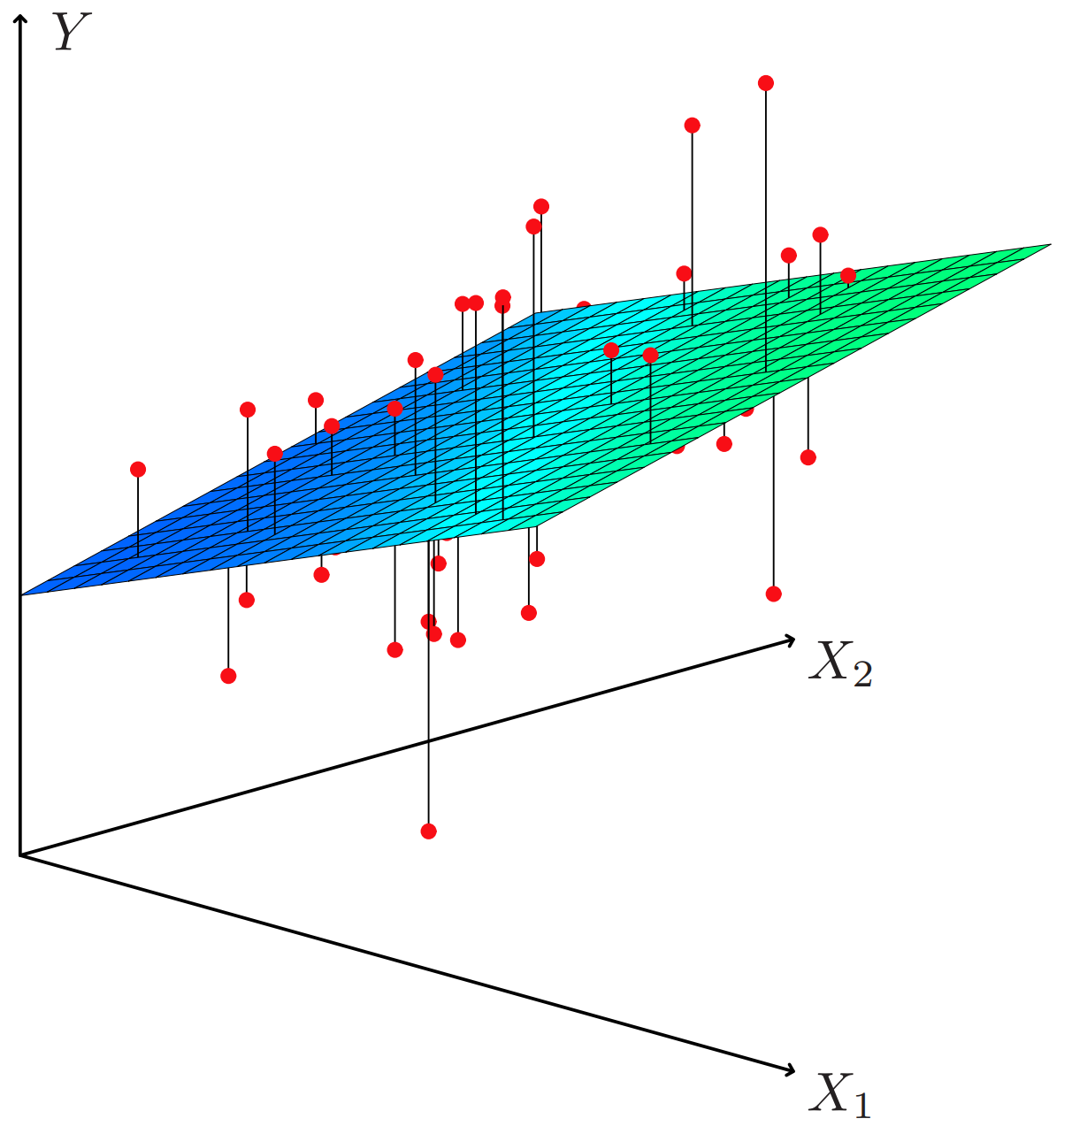
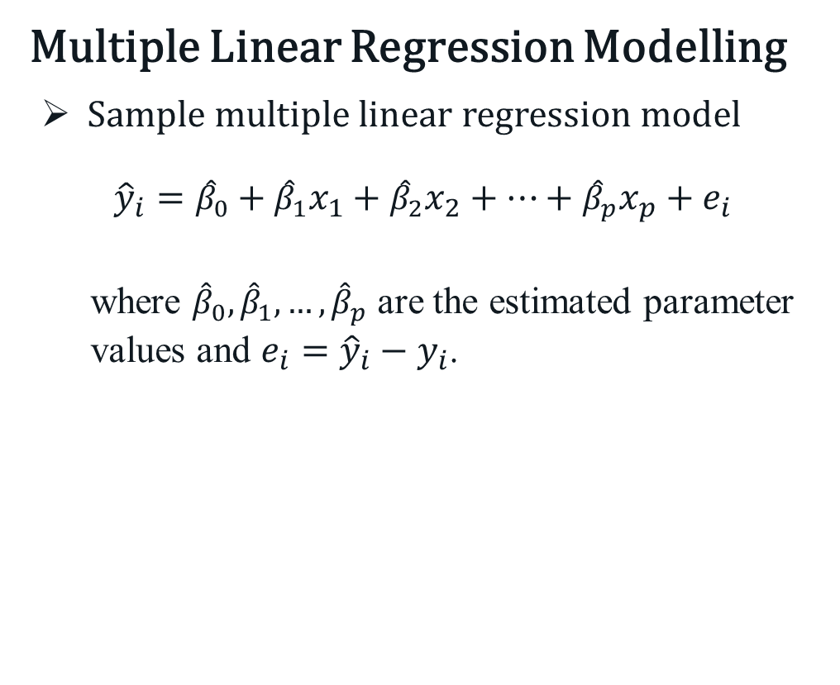
Linear Regression - MLR
Multiple Linear Regression Modelling
Sample multiple linear regression model
$${\hat{y}}_{i}={\hat{β}}_{0}+{\hat{β}}_{1}x_{1}+{\hat{β}}_{2}x_{2}+⋯+{\hat{β}}_{p}x_{p}+e_{i}$$
where ${\hat{β}}_{0},{\hat{β}}_{1}, …,{\hat{β}}_{p}$ are the estimated parameter values and $e_{i}={\hat{y}}_{i}−y_{i}$.

Slide 33
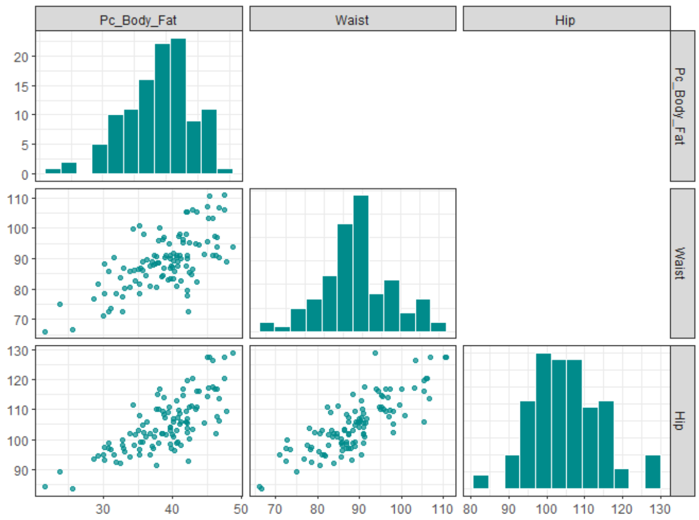
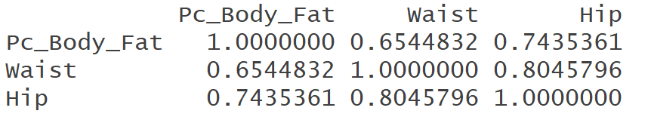
Linear Regression - MLR
Example – ElderlyWAPop.csv
Suppose we want to regress % body fat (outcome) against Waist and Hip circumference (2 predictors).
Correlation matrix

Slide 34
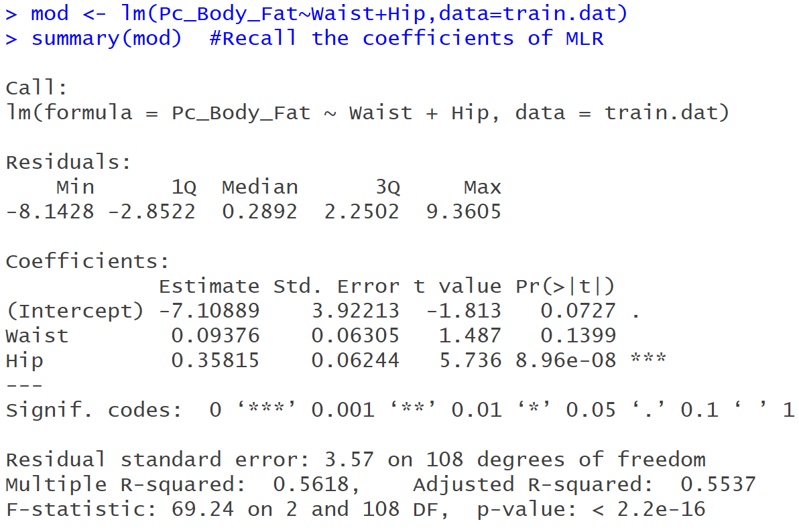
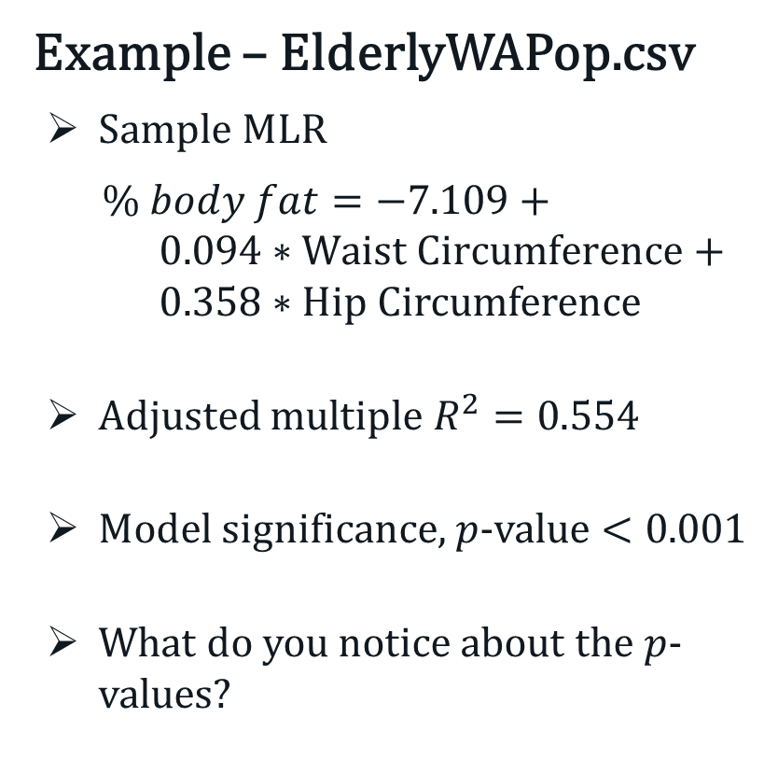
Linear Regression - MLR
Example – ElderlyWAPop.csv
Sample MLR
$\% body fat=−7.109+ 0.094∗Waist Circumference+ 0.358∗Hip Circumference$
Adjusted multiple $R^{2}=0.5$54
Model significance, $p$-value $<0.001$
What do you notice about the $p$-values?

Slide 35
Linear Regression - MLR
Multi-collinearity (or collinearity)
Refers to situation where a predictor can be linearly predicted from one or more of the other predictors of interest with a substantial degree of accuracy.
At the base-level, collinearity occurs when two or more highly correlated predictors are simultaneously included in the model.
Does not reduce the predictive power and accuracy of the model (within the training data).
Can adversely affect the parameter estimates and their standard error estimates, and hence their significance.

Slide 36
Linear Regression - MLR
Multi-collinearity (or collinearity)
Refers to situation where a predictor can be linearly predicted from one or more of the other predictors of interest with a substantial degree of accuracy.
At the base-level, collinearity occurs when two or more highly correlated predictors are simultaneously included in the model.
Does not reduce the predictive power and accuracy of the model (within the training data).
Can adversely affect the parameter estimates and their standard error estimates, and hence their significance.

Slide 37
Linear Regression - MLR
How to detect collinearity?
Variance inflation factor (VIF) ≥ 5 or 10. Not applicable to non-linear regression modelling.
Large change in the estimate when a collinearly-related variable is introduced into the model. This includes changing of the sign.
Overall F of the model is significant, but none of the predictors are.
High bivariate correlations (>0.7) in a correlation matrix.

Slide 38
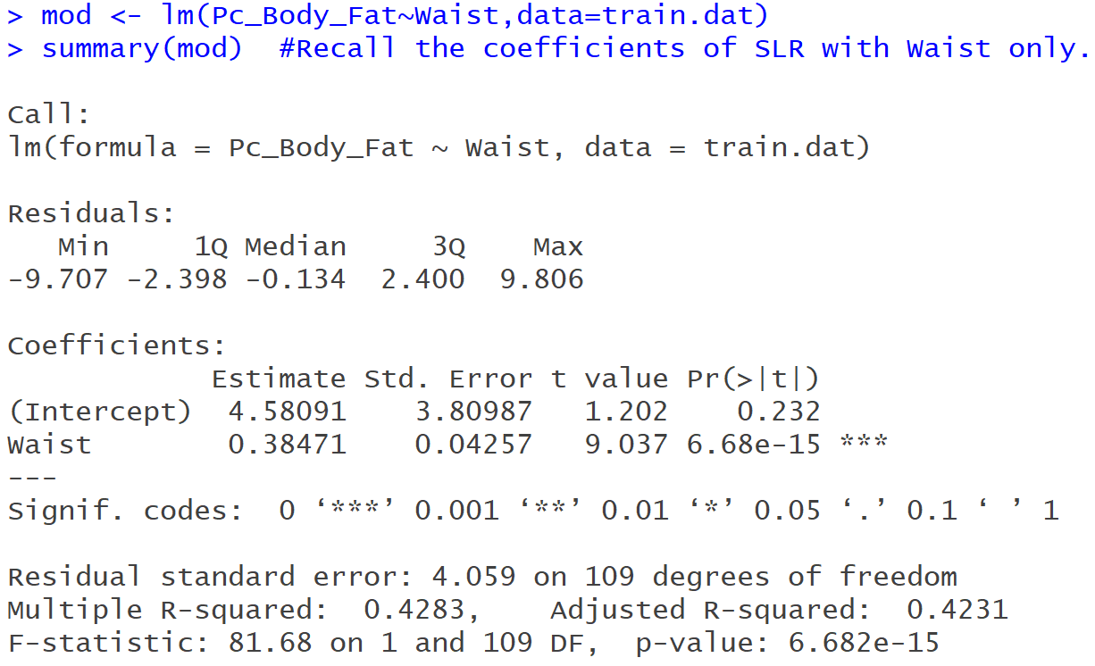
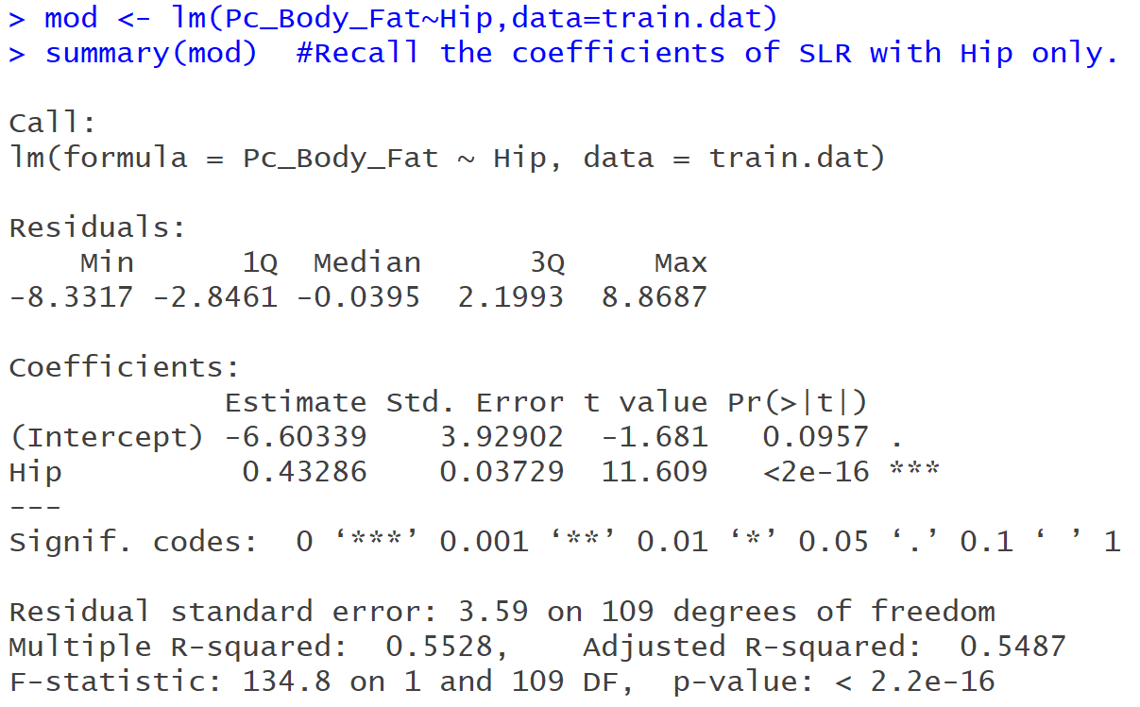
Linear Regression - MLR
Example of Collinearity
(a) With waist only (b) With hip only

Slide 39
Linear Regression - MLR
Remedies?
Leave the model as is, however, this may lead to overfitting
Drop one of the correlated variables (a common approach)
Perform stepwise regression
Increase sample size
Use principle component regression or partial least-squares
Use penalised regression

